Slide 1
Chapter 1: Introduction

Slide 2
Chapter 1: Introduction
What Operating Systems Do
Computer-System Organization
Computer-System Architecture
Operating-System Structure
Operating-System Operations
Process Management
Memory Management
Storage Management
Protection and Security
Kernel Data Structures
Computing Environments
Open-Source Operating Systems

Slide 3
Objectives
To describe the basic organization of computer systems
To provide a grand tour of the major components of operating systems
To give an overview of the many types of computing environments

Slide 4
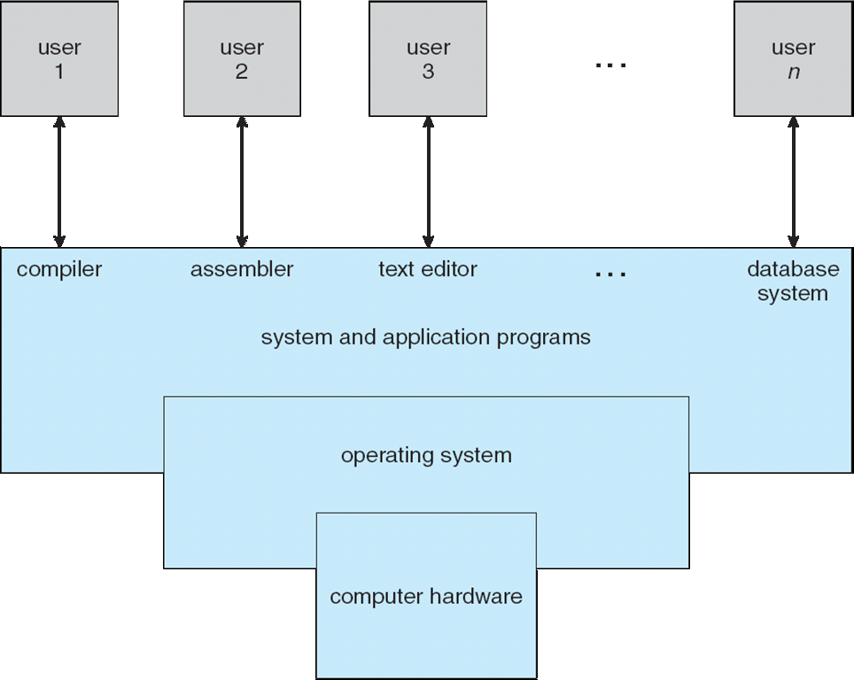
Four Components of a Computer System

Slide 5
Computer System Structure
Computer system can be divided into four components:
  Hardware – provides basic computing resources
    CPU, memory, I/O devices
  Operating system
    Controls and coordinates use of hardware among various applications and users
  Application programs – define the ways in which the system resources are used to solve the computing problems of the users
    Word processors, compilers, web browsers, database systems, video games
  Users
    People, machines, other computers

Slide 6
What is an Operating System?
A program that acts as an intermediary between a user of a computer and the computer hardware
Operating system goals:
  Execute user programs and make solving user problems easier
  Make the computer system convenient to use
  Use the computer hardware in an efficient manner

Slide 7
What Operating Systems Do
Users view
Users want convenience, ease of use and good performance
  Don’t care about resource utilization
System view
OS is a resource allocator
  Manages all resources
  Decides between conflicting requests for efficient and fair resource use
OS is a control program
  Controls execution of programs to prevent errors and improper use of the computer

Slide 8
Operating System Definition (Cont.)
No universally accepted definition
“Everything a vendor ships when you order an operating system” is a good approximation
  But varies wildly
“The one program running at all times on the computer” is the kernel.
Everything else is either
  a system program (ships with the operating system) , or
  an application program.

Slide 9
Computer Startup
bootstrap program is loaded at power-up or reboot
  Typically stored in ROM or EPROM, generally known as firmware
  Initializes all aspects of system
  Loads operating system kernel and starts execution

Slide 10
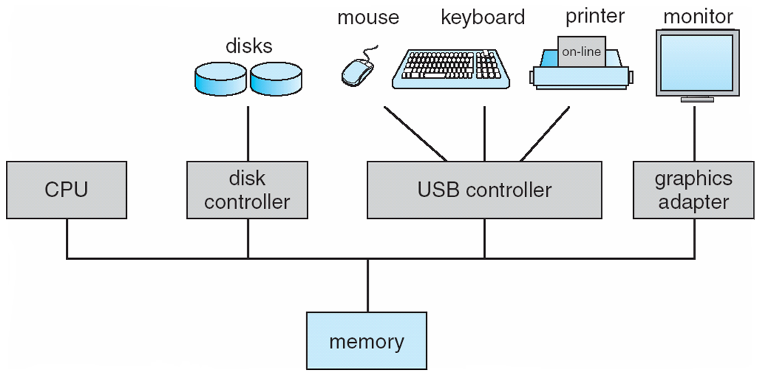
Computer System Organization
Computer-system operation
  One or more CPUs, device controllers connect through common bus providing access to shared memory
  Concurrent execution of CPUs and devices competing for memory cycles

Slide 11
Computer-System Operation
I/O devices and the CPU can execute concurrently
Each device controller is in charge of a particular device type
Each device controller has a local buffer
CPU moves data from/to main memory to/from local buffers
I/O is from the device to local buffer of controller
Device controller informs CPU that it has finished its operation by causing an interrupt

Slide 12
Common Functions of Interrupts
Interrupt transfers control to the interrupt service routine generally, through the interrupt vector, which contains the addresses of all the service routines
Interrupt architecture must save the address of the interrupted instruction
A trap or exception is a software-generated interrupt caused either by an error or a user request
An operating system is interrupt driven

Slide 13
I/O Structure
After I/O starts, control returns to user program only upon I/O completion
  Wait instruction idles the CPU until the next interrupt
  Wait loop (contention for memory access)
  At most one I/O request is outstanding at a time, no simultaneous I/O processing
After I/O starts, control returns to user program without waiting for I/O completion
  System call – request to the OS to allow user to wait for I/O completion
  Device-status table contains entry for each I/O device indicating its type, address, and state
  OS indexes into I/O device table to determine device status and to modify table entry to include interrupt

Slide 14
Storage Definitions and Notation Review
The basic unit of computer storage is the bit. A bit can contain one of two values, 0 and 1. All other storage in a computer is based on collections of bits. Given enough bits, it is amazing how many things a computer can represent: numbers, letters, images, movies, sounds, documents, and programs, to name a few. A byte is 8 bits, and on most computers it is the smallest convenient chunk of storage. For example, most computers don’t have an instruction to move a bit but do have one to move a byte. A less common term is word, which is a given computer architecture’s native unit of data. A word is made up of one or more bytes. For example, a computer that has 64-bit registers and 64-bit memory addressing typically has 64-bit (8-byte) words. A computer executes many operations in its native word size rather than a byte at a time.
Computer storage, along with most computer throughput, is generally measured and manipulated in bytes and collections of bytes.
A kilobyte, or KB, is 1,024 bytes
a megabyte, or MB, is 1,024² bytes
a gigabyte, or GB, is 1,024³ bytes
a terabyte, or TB, is 1,024⁴ bytes
a petabyte, or PB, is 1,024⁵ bytes
Computer manufacturers often round off these numbers and say that a megabyte is 1 million bytes and a gigabyte is 1 billion bytes. Networking measurements are an exception to this general rule; they are given in bits (because networks move data a bit at a time).

Slide 15
Storage Structure
Main memory – only large storage media that the CPU can access directly
  Random access
  Typically volatile
Secondary storage – extension of main memory that provides large nonvolatile storage capacity
Hard disks – rigid metal or glass platters covered with magnetic recording material
  Disk surface is logically divided into tracks, which are subdivided into sectors
  The disk controller determines the logical interaction between the device and the computer
Solid-state disks – faster than hard disks, nonvolatile
  Various technologies
  Becoming more popular

Slide 16
Storage Hierarchy
Storage systems organized in hierarchy
  Speed
  Cost
  Volatility
Caching – copying information into faster storage system; main memory can be viewed as a cache for secondary storage
Device Driver for each device controller to manage I/O
  Provides uniform interface between controller and kernel

Slide 17
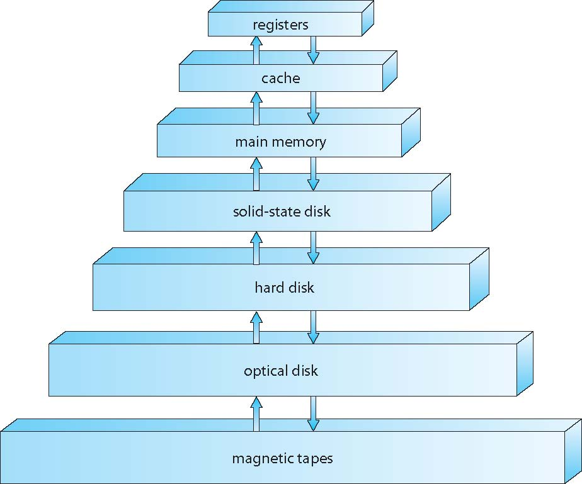
Storage-Device Hierarchy

Slide 18
Caching
Important principle, performed at many levels in a computer (in hardware, operating system, software)
Information in use copied from slower to faster storage temporarily
Faster storage (cache) checked first to determine if information is there
  If it is, information used directly from the cache (fast)
  If not, data copied to cache and used there
Cache smaller than storage being cached
  Cache management important design problem
  Cache size and replacement policy

Slide 19
Computer-System Architecture
Most systems use a single general-purpose processor
  Most systems have special-purpose processors as well
Multiprocessors systems growing in use and importance
  Also known as parallel systems, tightly-coupled systems
  Advantages include:
    Increased throughput
    Economy of scale
    Increased reliability – graceful degradation or fault tolerance
  Two types:
    Asymmetric Multiprocessing – each processor is assigned a specie task.
    Symmetric Multiprocessing – each processor performs all tasks

Slide 20
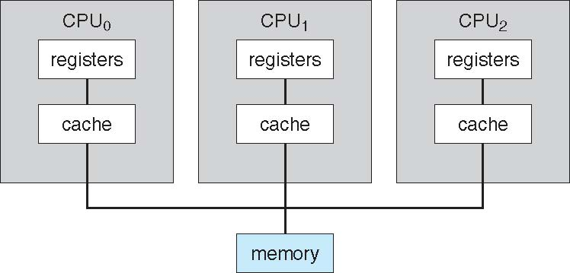
Symmetric Multiprocessing Architecture

Slide 21
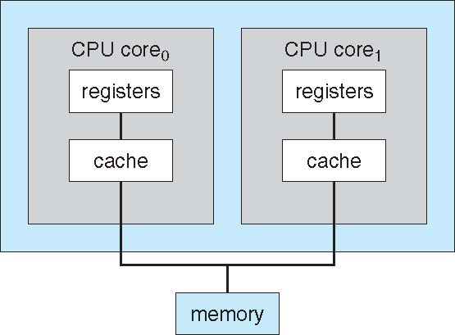
A Dual-Core Design
Multi-chip and multicore
Systems containing all chips
  Chassis containing multiple separate systems

Slide 22
Clustered Systems
Like multiprocessor systems, but multiple systems working together
  Usually sharing storage via a storage-area network (SAN)
  Provides a high-availability service which survives failures
    Asymmetric clustering has one machine in hot-standby mode
    Symmetric clustering has multiple nodes running applications, monitoring each other
  Some clusters are for high-performance computing (HPC)
    Applications must be written to use parallelization

Slide 23
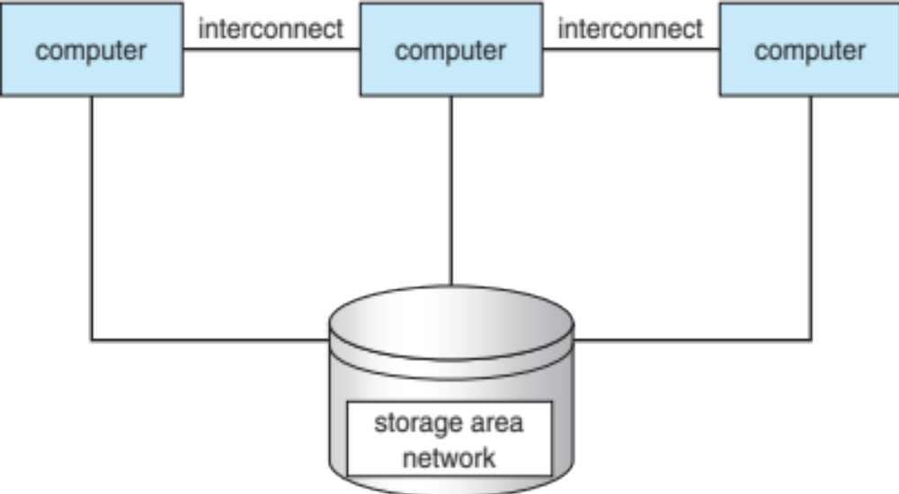
Clustered Systems

Slide 24
Operating System Structure
Multiprogramming (Batch system) needed for efficiency
  Single user cannot keep CPU and I/O devices busy at all times
  Multiprogramming organizes jobs (code and data) so CPU always has one to execute
  A subset of total jobs in system is kept in memory
  One job selected and run via job scheduling
  When it has to wait (for I/O for example), OS switches to another job
Timesharing (multitasking) is logical extension in which CPU switches jobs so frequently that users can interact with each job while it is running, creating interactive computing
  Response time should be < 1 second
  Each user has at least one program executing in memory process
  If several jobs ready to run at the same time  CPU scheduling
  If processes don’t fit in memory, swapping moves them in and out to run
  Virtual memory allows execution of processes not completely in memory

Slide 25
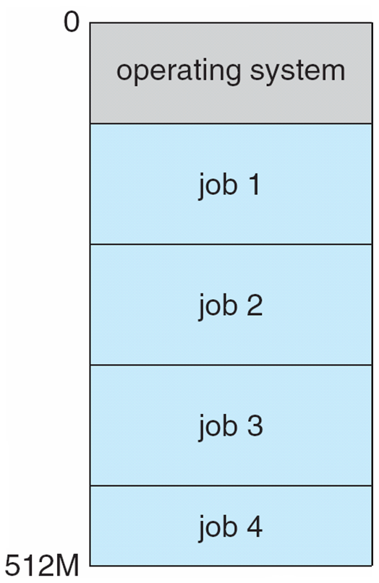
Memory Layout for Multiprogrammed System

Slide 26
Operating-System Operations (cont.)
Dual-mode operation allows OS to protect itself and other system components
  User mode and kernel mode
  Mode bit provided by hardware
    Provides ability to distinguish when system is running user code or kernel code
    Some instructions designated as privileged, only executable in kernel mode
    System call changes mode to kernel, return from call resets it to user

Slide 27

Transition from User to Kernel Mode
Timer to prevent infinite loop / process hogging resources
  Timer is set to interrupt the computer after some time period
  Keep a counter that is decremented by the physical clock.
  Operating system set the counter (privileged instruction)
  When counter zero generate an interrupt
  Set up before scheduling process to regain control or terminate program that exceeds allotted time

Slide 28
Process Management Activities
The operating system is responsible for the following activities in connection with process management:
Creating and deleting both user and system processes
Suspending and resuming processes
Providing mechanisms for process synchronization
Providing mechanisms for process communication
Providing mechanisms for deadlock handling

Slide 29
Memory Management
To execute a program all (or part) of the instructions must be in memory
All (or part) of the data that is needed by the program must be in memory.
Memory management determines what is in memory and when
  Optimizing CPU utilization and computer response to users
Memory management activities
  Keeping track of which parts of memory are currently being used and by whom
  Deciding which processes (or parts) and data to move into and out of memory
  Allocating and deallocating memory space as needed

Slide 30
Storage Management
OS provides uniform, logical view of information storage
  Abstracts physical properties to logical storage unit - file
  Each medium is controlled by device (i.e., disk drive, tape drive)
    Varying properties include access speed, capacity, data-transfer rate, access method (sequential or random)
File-System management
  Files usually organized into directories
  Access control on most systems to determine who can access what
  OS activities include
    Creating and deleting files and directories
    Primitives to manipulate files and directories
    Mapping files onto secondary storage
    Backup files onto stable (non-volatile) storage media

Slide 31
Mass-Storage Management
Usually disks used to store data that does not fit in main memory or data that must be kept for a “long” period of time
Proper management is of central importance
Entire speed of computer operation hinges on disk subsystem and its algorithms
OS activities
  Free-space management
  Storage allocation
  Disk scheduling
Some storage need not be fast
  Tertiary storage includes optical storage, magnetic tape
  Still must be managed – by OS or applications
  Varies between WORM (write-once, read-many-times) and RW (read-write)

Slide 32
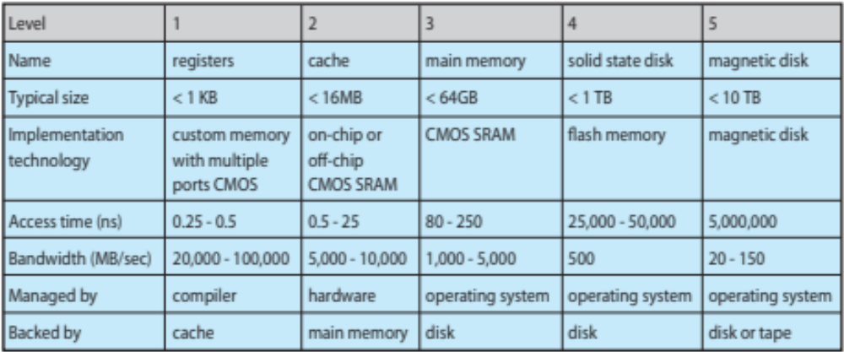
Performance of Various Levels of Storage
Movement between levels of storage hierarchy can be explicit or implicit

Slide 33
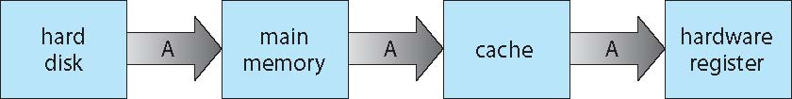
Migration of data “A” from Disk to Register
Multitasking environments must be careful to use most recent value, no matter where it is stored in the storage hierarchy
Multiprocessor environment must provide cache coherency in hardware such that all CPUs have the most recent value in their cache
Distributed environment situation even more complex
  Several copies of a datum can exist
  Various solutions covered in Chapter 17

Slide 34
End of Chapter 1

